Slide 1





A Decade of IPL: Unlocking Key Insights
Data Science Lab-I
Instructor:
Dr. Dootika Vats

Slide 2
Why this app?
One- Stop Solution for Simplified IPL Data
It makes IPL stats easy to explore and understand.
Helps with Performance Analysis
Provides insights into player and team performances over time.
Interactive Visualizations
Allows users to view and compare stats through easy-to-read charts and graphs.
Supports Data-Driven Decisions
It is useful for analysts and fans to gain deeper insights into match trends and player form.

Slide 3
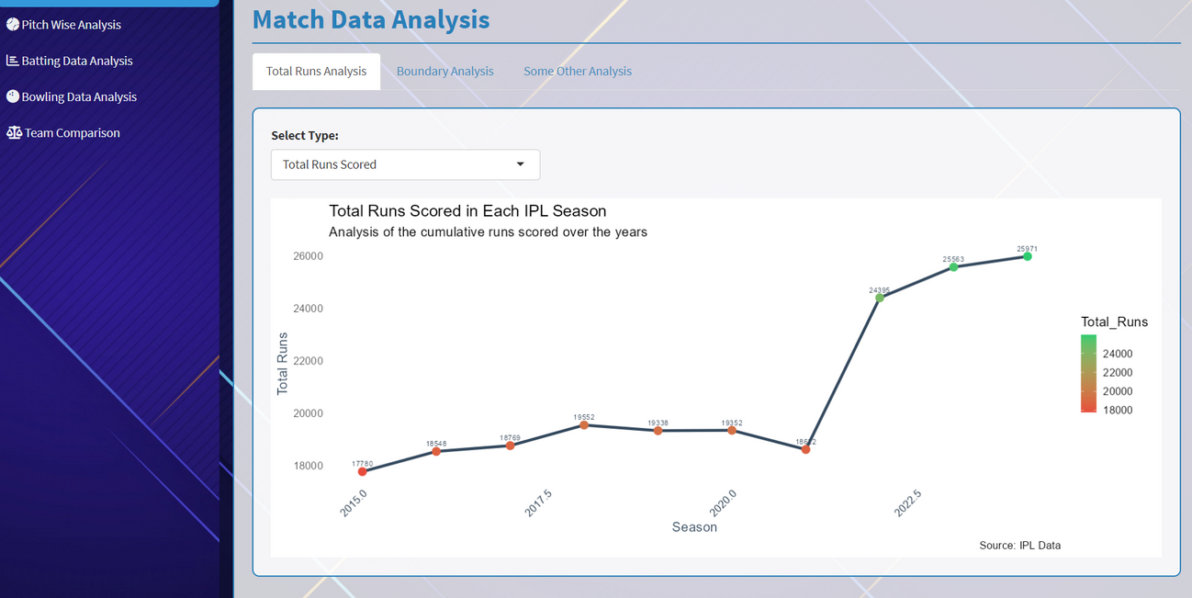
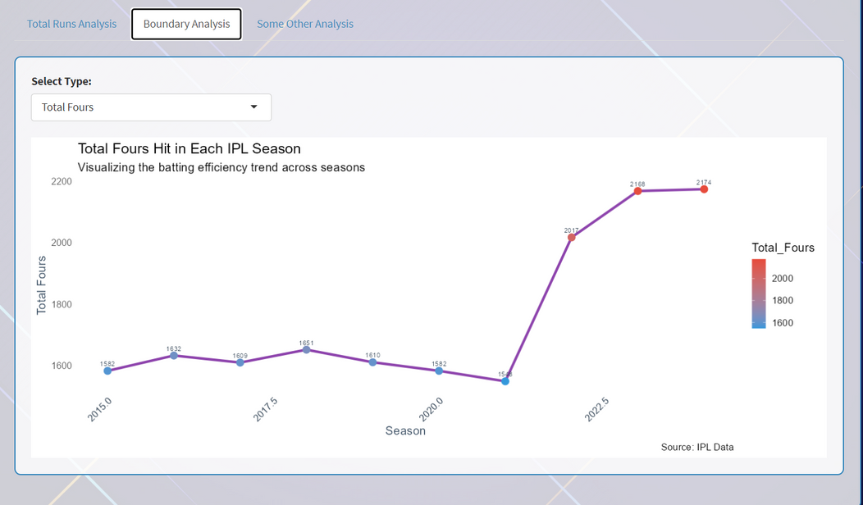
Match Data Analysis
Observation:
Total runs in the IPL have increased sharply over the years, especially after 2021.
Reasons:
Addition of two new teams in 2022: More matches and increased competition led to higher run totals.
Dip in 2021: The tournament was played in the UAE, where bowler-friendly pitches resulted in lower scores.

Slide 4
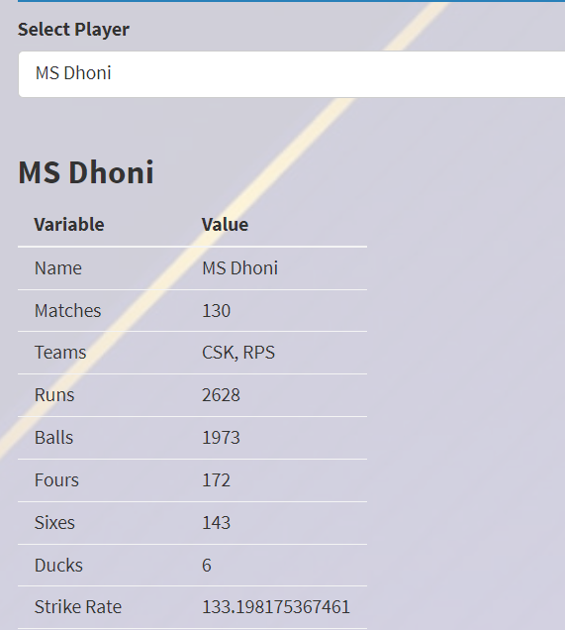

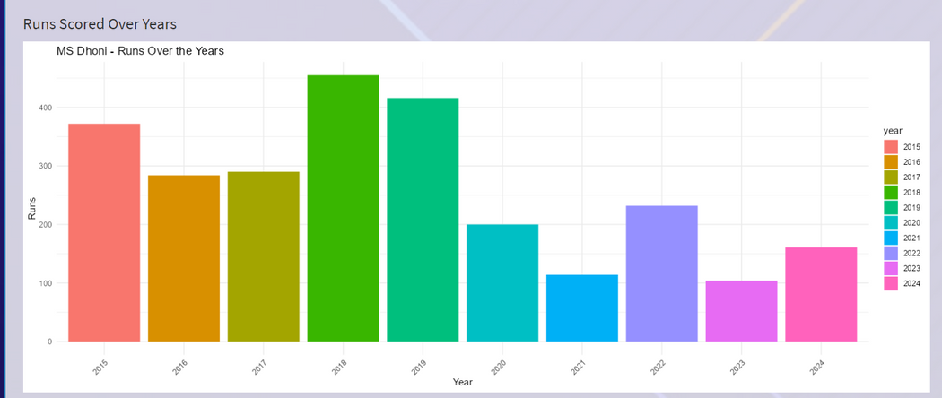
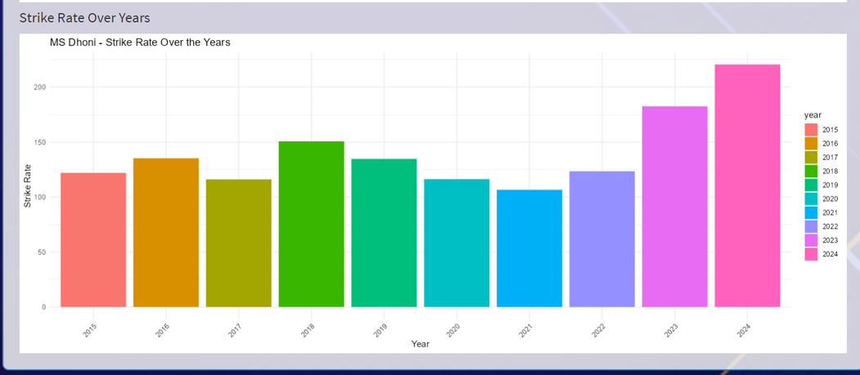
Batsman Performance Analysis: Runs Scored and Strike Rate Trends
Example: MS Dhoni
Runs Over the Years: MS Dhoni's total runs have decreased over the years, largely due to his role as a finisher, where he often batted in the death overs.
Increase in Strike Rate: As Dhoni's role evolved, his strike rate has notably increased, reflecting his ability to accelerate scoring in the final overs of innings.

Slide 5
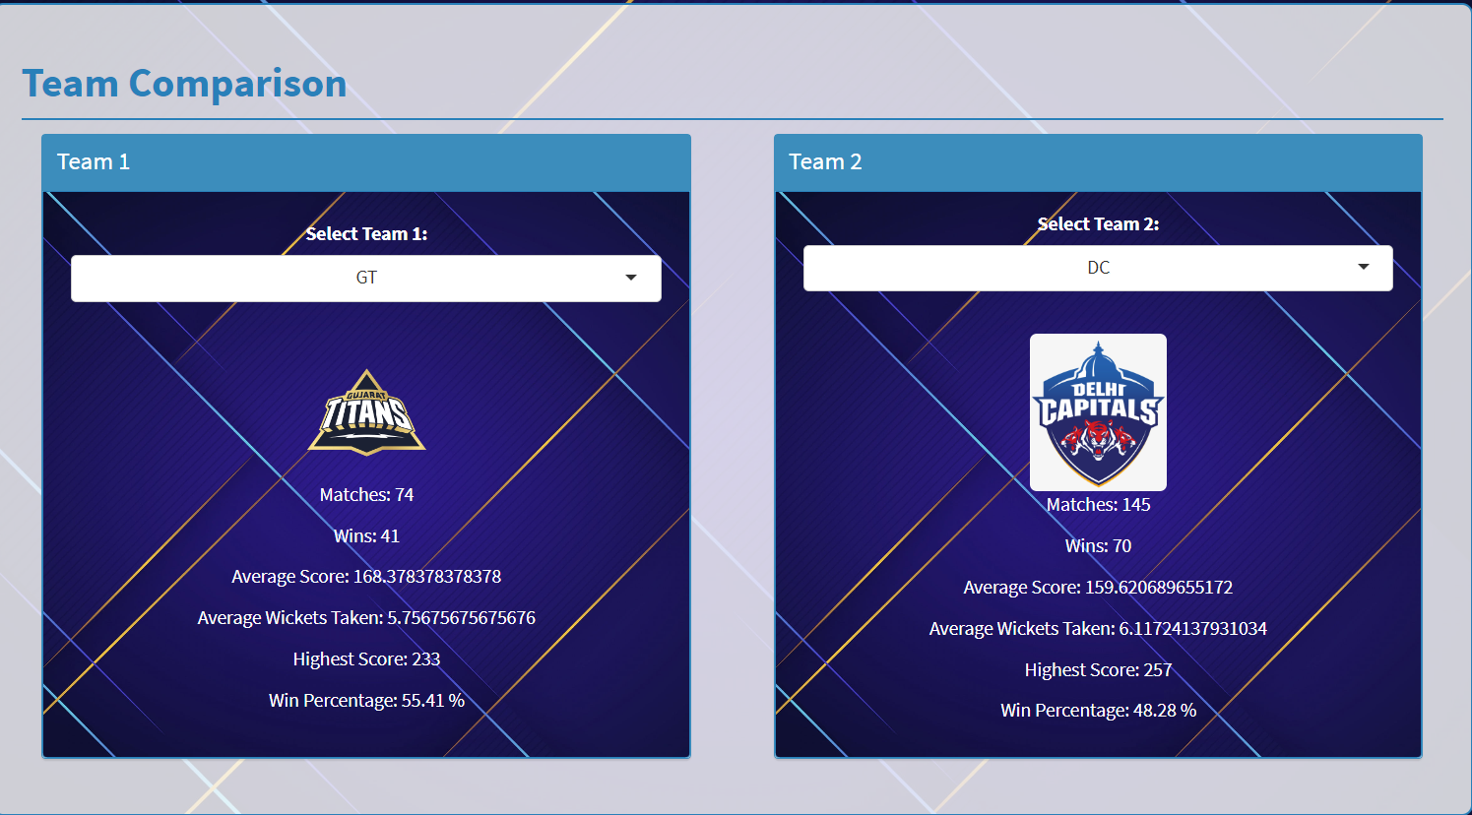
Team Comparison Analysis: Scores, Wickets, and Win Percentage
Teams can be directly compared based on metrics like win percentage, total runs, average wickets, and highest scores.
This comparison helps identify potential strengths and weaknesses of teams before a match, providing valuable insights into team strategies.

Slide 6
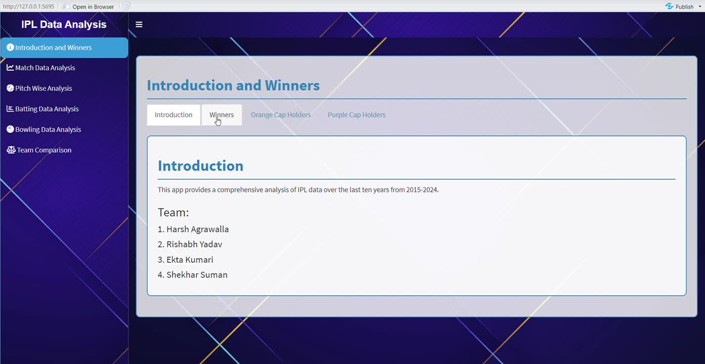
App Demo

Slide 7
THANK YOU
Group 5
1. Harsh Agrawalla
2. Rishabh Yadav
3. Ekta Kumari
4. Shekhar Suman

